Slide 1



Slide 2


Topic:
(HCI)

Slide 3
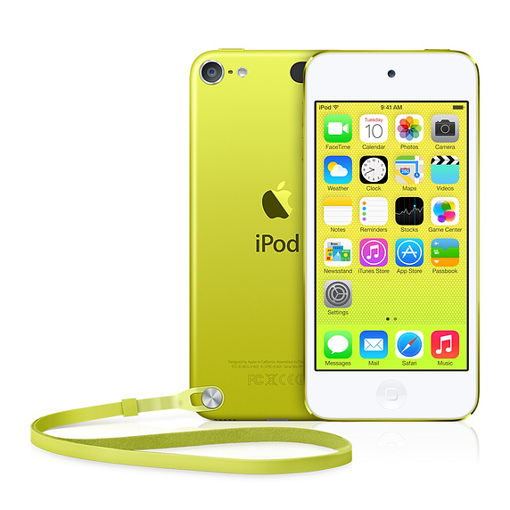
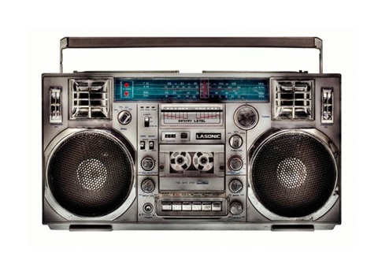
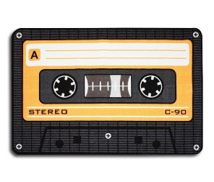
Radio Player
iPod

Slide 4

Why we use iPod ?
- It’s easy to use and obviously enjoyable
We can interact with it more easily.

Slide 5


Slide 6
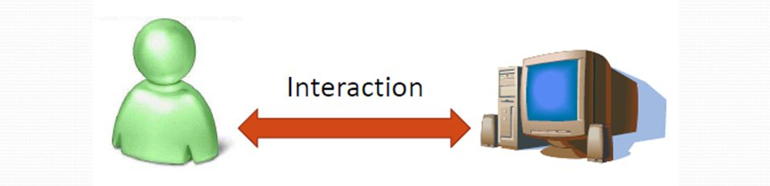
What is HCI ?
HCI (human-computer interaction) is the study of how people interact with computers

Slide 7

Interaction

Slide 8
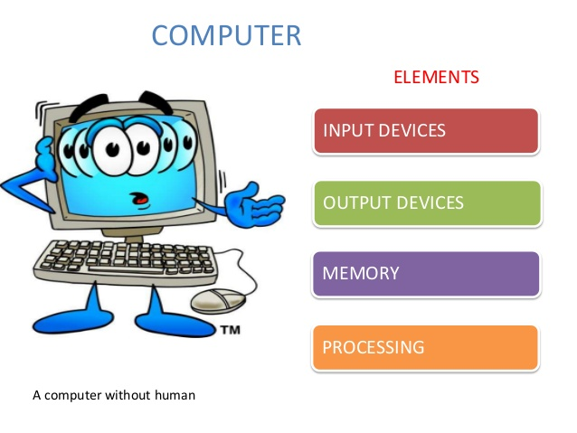
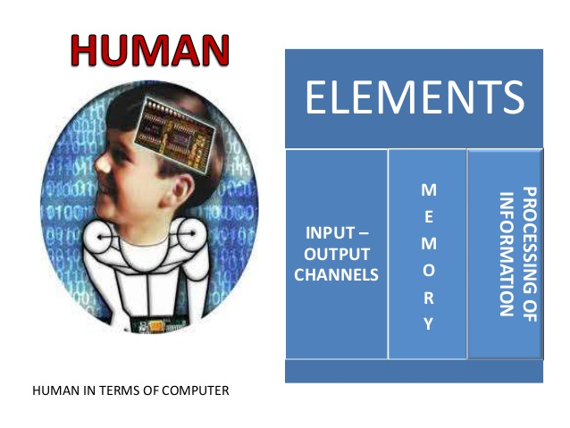

Slide 9
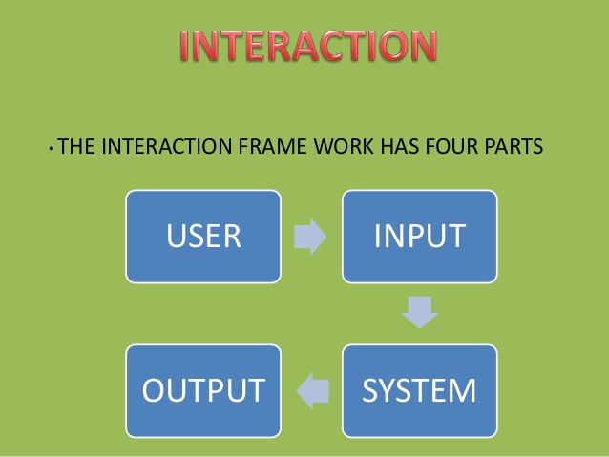

Slide 10
The Goals of HCI

Slide 11
The Goals of HCI
→ understand the factors that determine how people use technology
→ develop tools and techniques to enable building suitable systems
→ achieve efficient, effective, and safe interaction

Slide 12

Usability

Slide 13
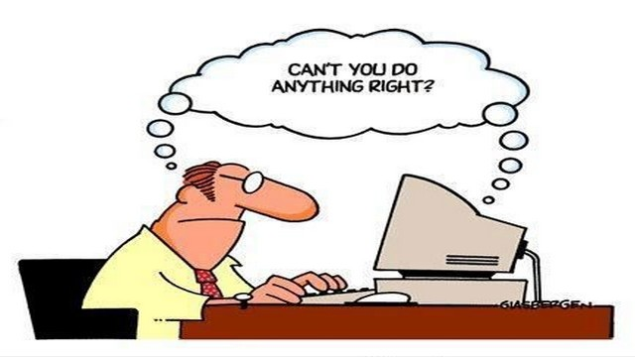
Usability is concerned with making systems easy to learn and use.

Slide 14
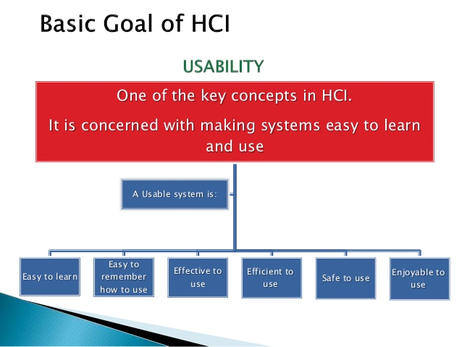

Slide 15
Disciplines contributing to HCI :
The field of HCI covers a wide range of topics, and its development has relied on contributions from many disciplines. Some of the main disciplines which have contributed to HCI are:
Computer Science > technology > software design, development & maintenance > User Interface (UI) > graphics
Engineering & Design > graphic design > engineering principles
Linguistics > natural language interfaces
Artificial Intelligence > intelligent software

Slide 16
Example of HCI

Slide 17


Slide 18

MD. Tariquel Islam Tamim
Dept. of Computer Science and Engineering
(CSE-19)

